Slide 1
3 Minute thesis
Please provide the information requested on the next two slides. Do not change the font, colour, size, etc.
Save this presentation with the following information: 3MTYourlastname2023. This means that the filename for
the presentation provided by Benedict Cumberbatch will be: 3MTCumberbatch2023.
Then send the presentation to: fosawards.ubco@ubc.ca
Thank you!

Slide 2
Stefano Mezzini
How will climate change affect mammal movement in the next century?
Program: Biology
Supervisor: Dr. Michael J. Noonan

Slide 3
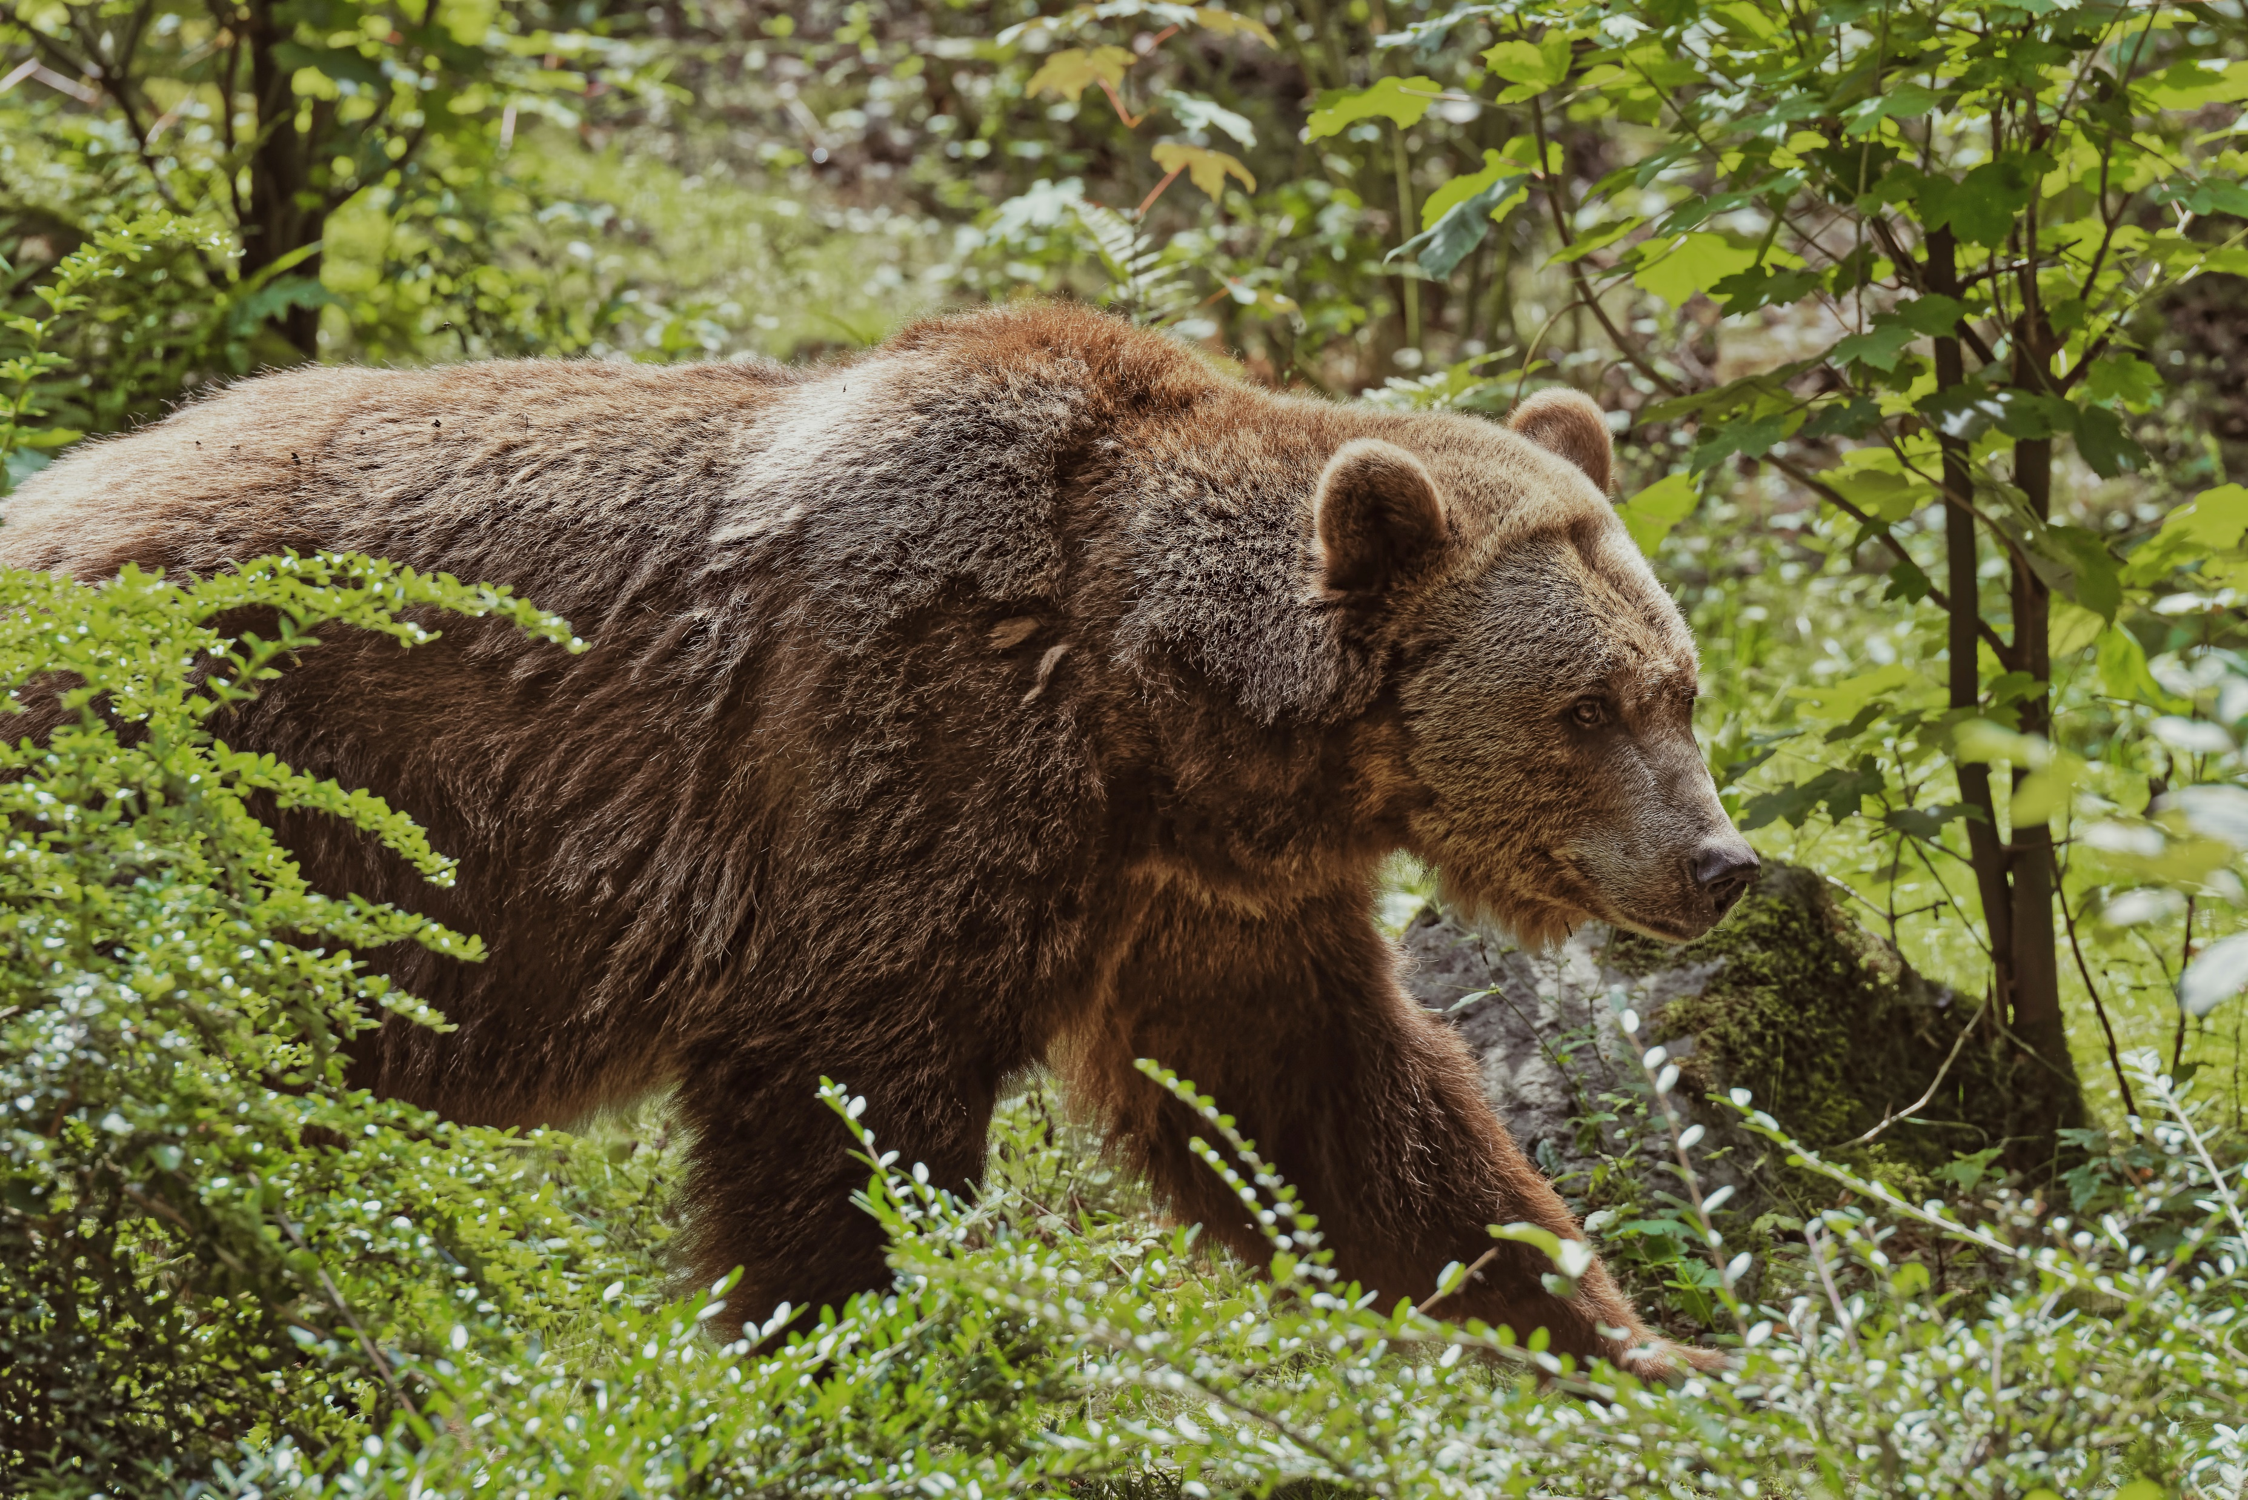
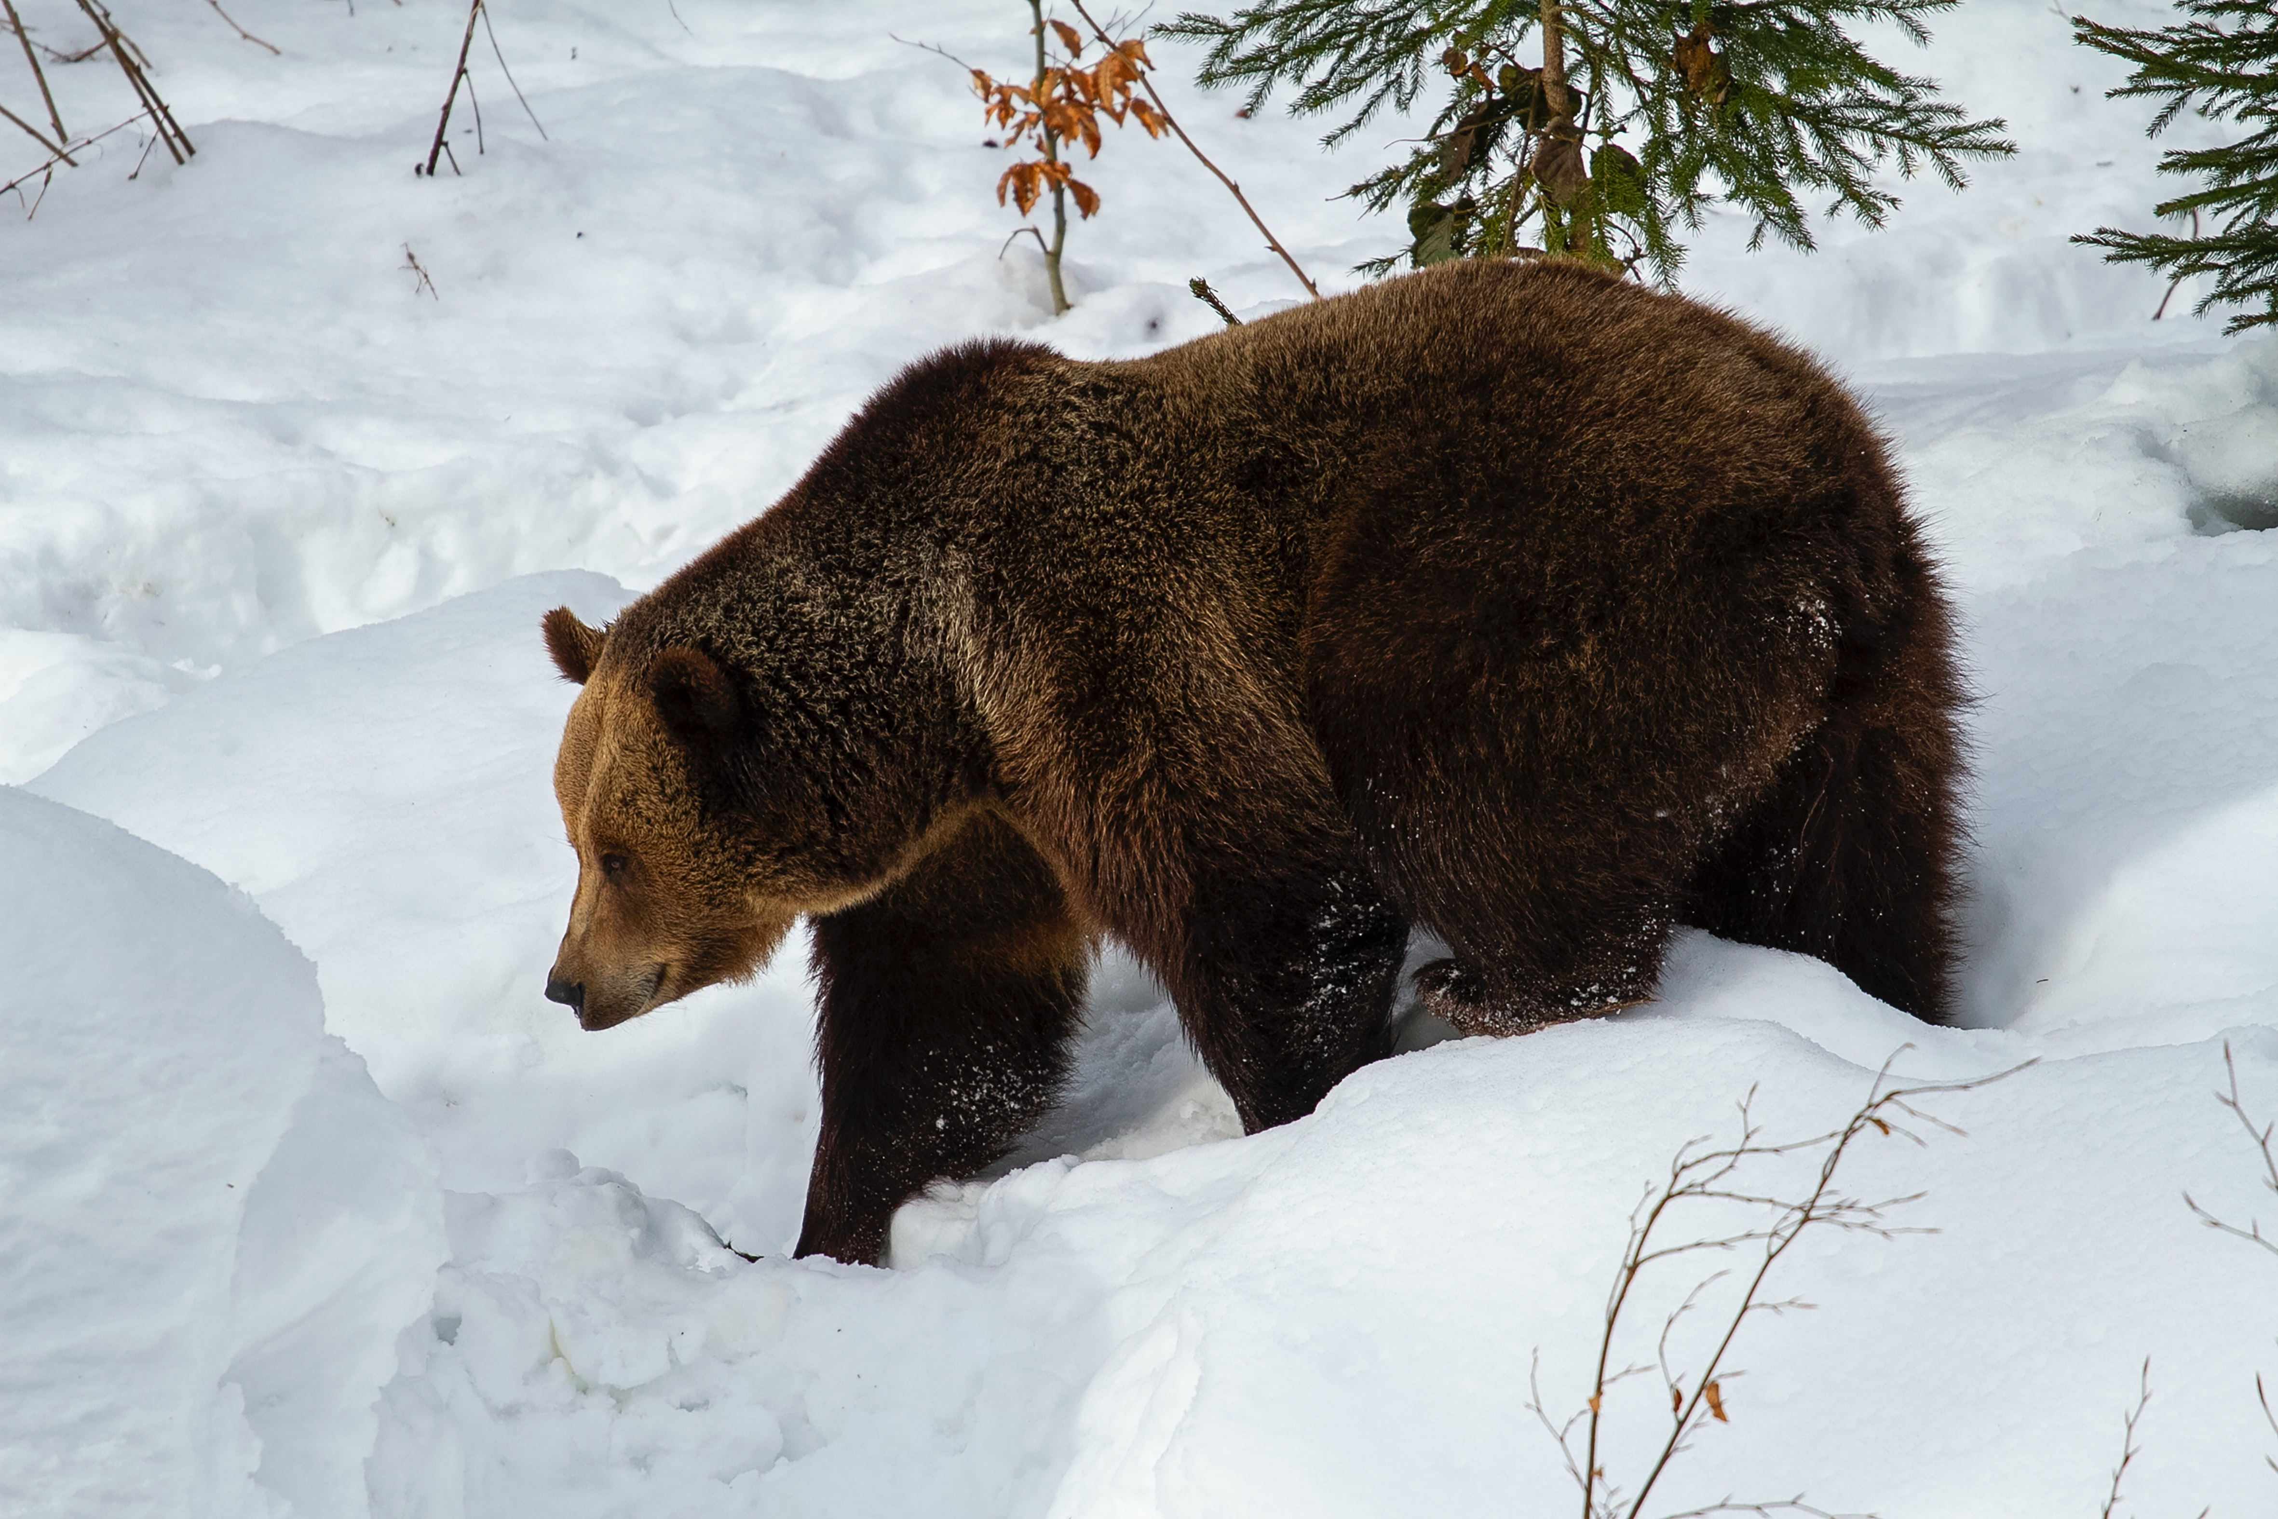
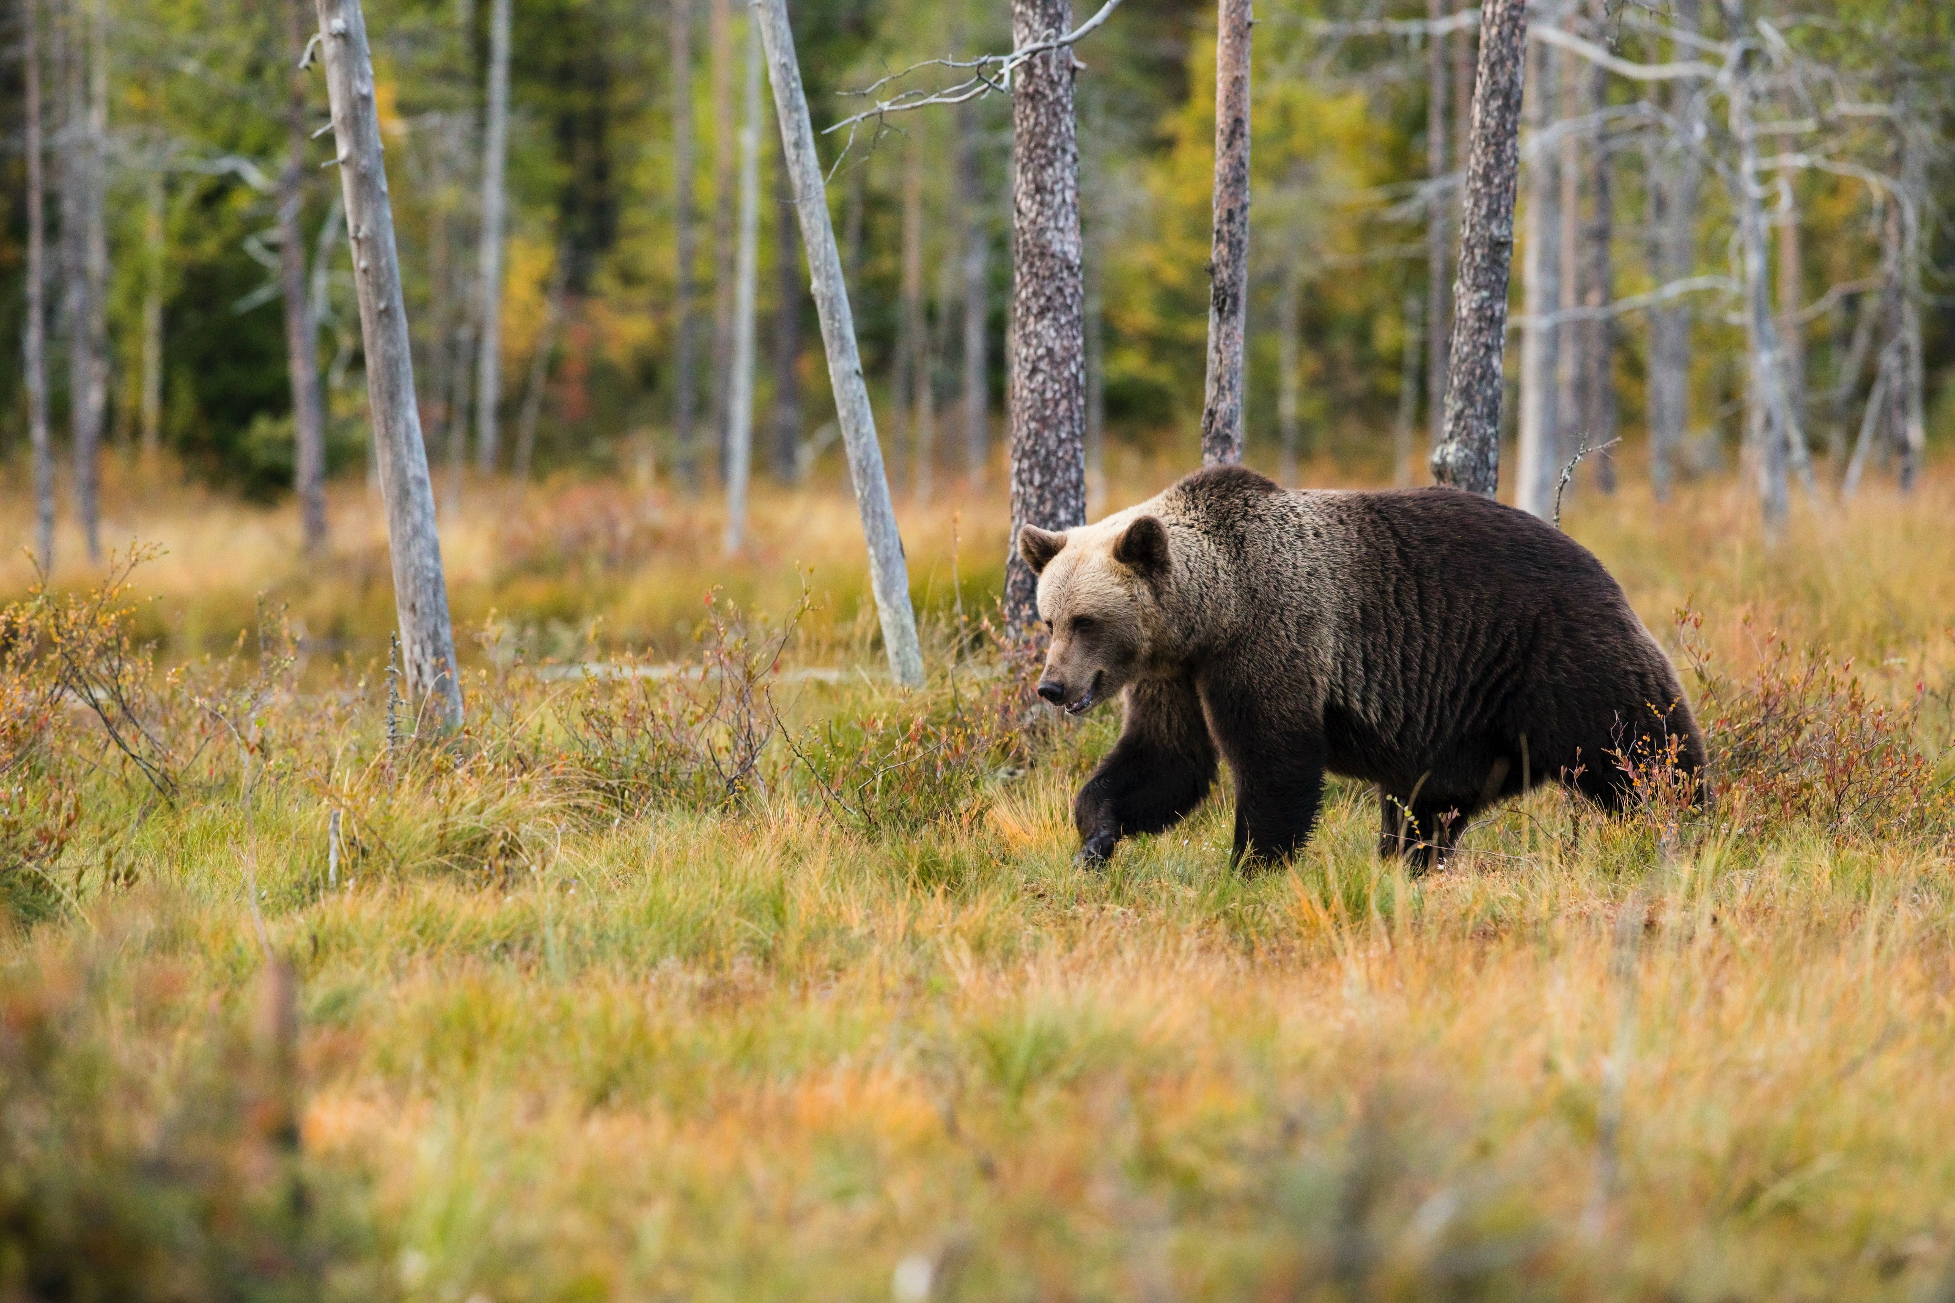
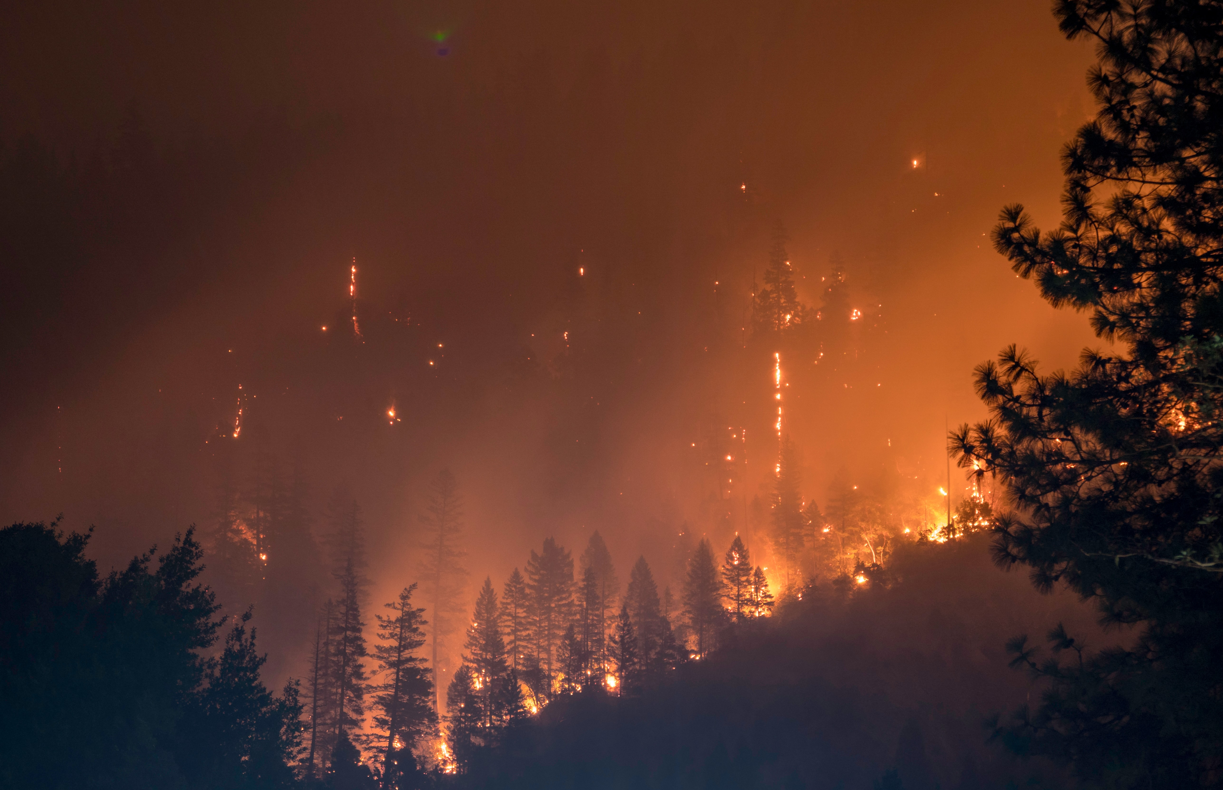
High resources
Low resources
Predictable
resources
Unpredictable resources

